Slide 1
DYNAMIC MALWARE ANALYSIS
By Mike McQuade

Slide 2
Abstract
Dynamic malware analysis is typically not reproducible.
The environment conditions can greatly impact how a piece of malware behaves.

Slide 3
Abstract
Dynamic malware analysis is typically not reproducible.
The environment conditions can greatly impact how a piece of malware behaves.
Solution: Create a snapshot to reproduce environment.

Slide 4
Introduction
To protect technology, we must use technology.

Slide 5
Introduction
To protect technology, we must use technology.
Static analysis is not able to adapt to a rapidly changing landscape. Dynamic analysis is much more effective for this.

Slide 6
Introduction
To protect technology, we must use technology.
Static analysis is not able to adapt to a rapidly changing landscape. Dynamic analysis is much more effective for this.
Presenting a new tool: SecBox

Slide 7
Literature Review
Dynamic analysis is effective for detecting new, unidentified malware [1]

Slide 8
Literature Review
Dynamic analysis is effective for detecting new, unidentified malware [1]
Traditional static antivirus can only detect known malware [2]

Slide 9
Literature Review
Dynamic analysis is effective for detecting new, unidentified malware [1]
Traditional static antivirus can only detect known malware [2]
The problem with static analysis is:

Slide 10
Literature Review
Dynamic analysis is effective for detecting new, unidentified malware [1]
Traditional static antivirus can only detect known malware [2]
The problem with static analysis is:
  Malware signature list must be kept up-to-date

Slide 11
Literature Review
Dynamic analysis is effective for detecting new, unidentified malware [1]
Traditional static antivirus can only detect known malware [2]
The problem with static analysis is:
  Malware signature list must be kept up-to-date
  Custom malware is undetectable

Slide 12
Literature Review
Dynamic analysis is effective for detecting new, unidentified malware [1]
Traditional static antivirus can only detect known malware [2]
The problem with static analysis is:
  Malware signature list must be kept up-to-date
  Custom malware is undetectable
  Signatures are easy to change

Slide 13
Literature Review
Dynamic analysis is effective for detecting new, unidentified malware [1]
Traditional static antivirus can only detect known malware [2]
The problem with static analysis is:
  Malware signature list must be kept up-to-date
  Custom malware is undetectable
  Signatures are easy to change
  Encrypting/decrypting malware makes its signature unreadable

Slide 14
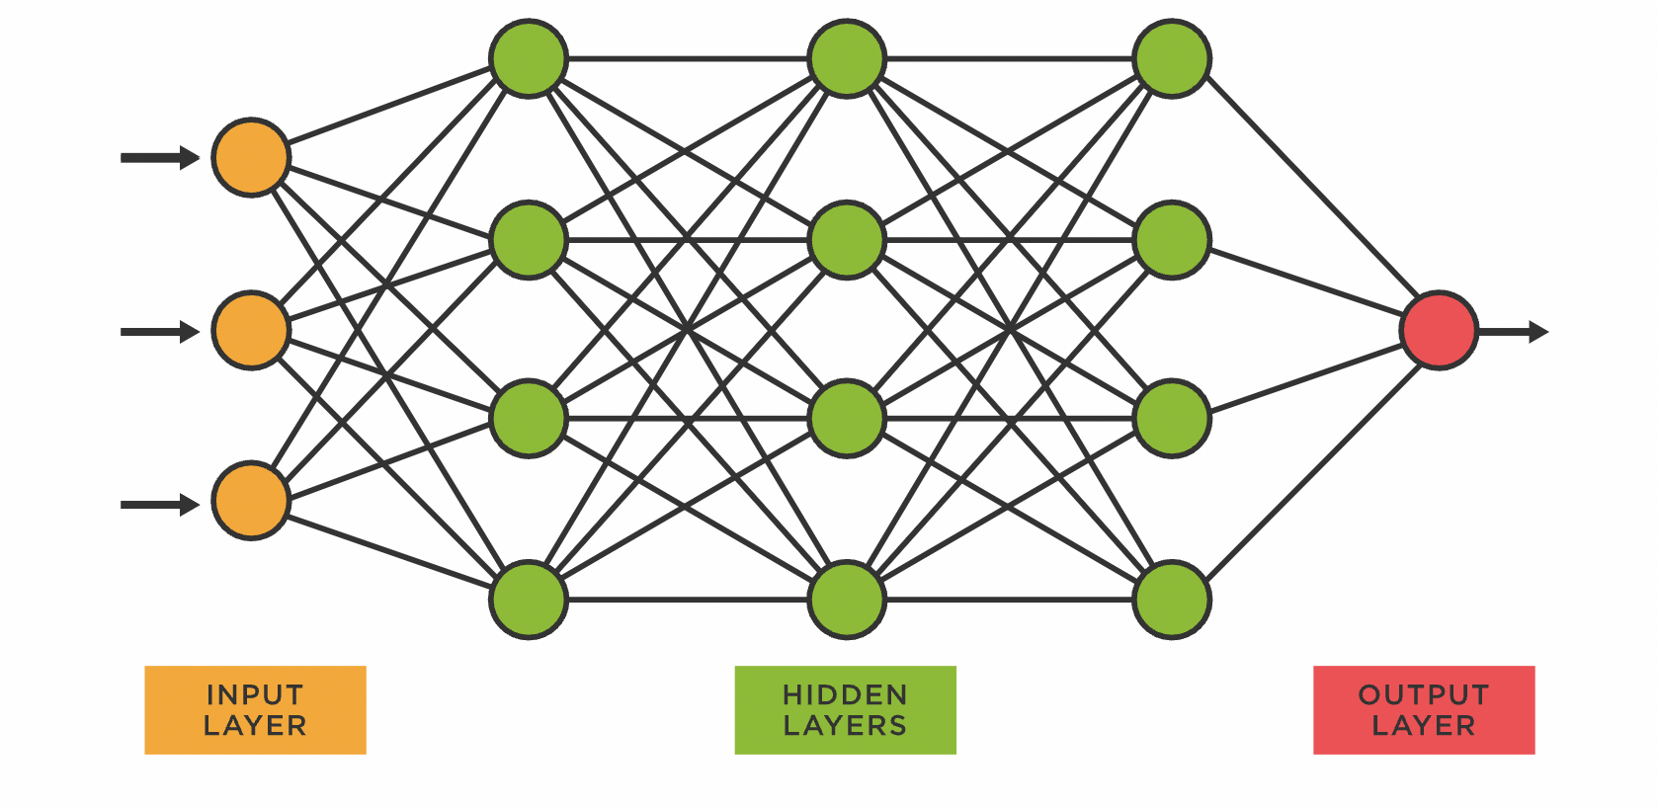
Solution
Behavior analysis can create a malware fingerprint without a frame of reference [1]

Slide 15
Drawbacks
Dynamic analysis is not reproducible.

Slide 16
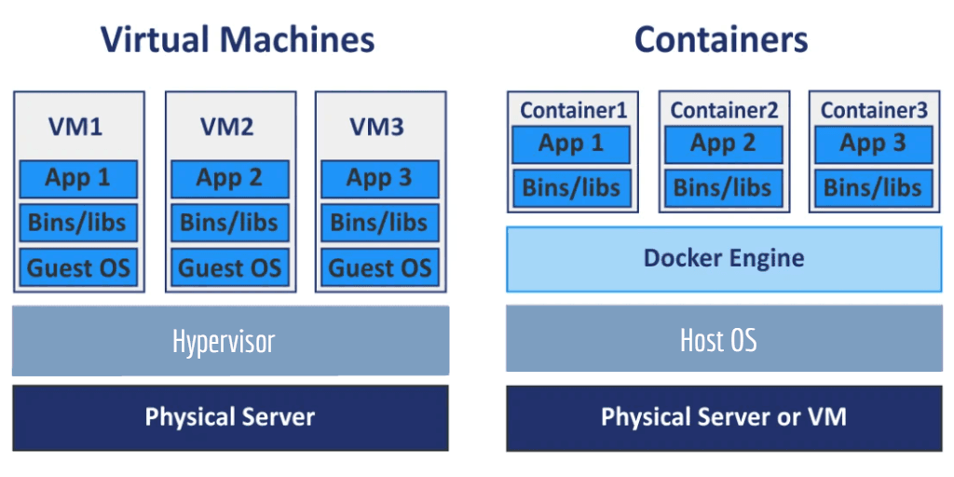
Drawbacks
Dynamic analysis is not reproducible.
Malware must be run in a sandboxed virtual machine to prevent damage to the host system. Typical VMs do not offer reproducible iterations [3]

Slide 17
Methodology
SecBox provides hardened virtual machines to isolate malware [3]
SecBox includes real-time data visualization.
All parameters used during program execution are saved.

Slide 18
Methodology
Referenced peer-reviewed article on SecBox [3]
Includes program architecture, runtime process, and post-mortem reports.
Performance: CPU, automation, reproducibility.

Slide 19
Methodology
Test environment:
  Ubuntu 22.04
  4 CPU cores, 2.4 GHz each
  16 GB RAM
  50 GB block storage

Slide 20
Methodology
Three unique scenarios:

Slide 21
Methodology
Three unique scenarios:
  Idle

Slide 22
Methodology
Three unique scenarios:
  Idle
  Running two Ubuntu sandboxes - no traffic on both

Slide 23
Methodology
Three unique scenarios:
  Idle
  Running two Ubuntu sandboxes - no traffic on both
  Running two Ubuntu sandboxes - one no traffic, one running CoinMiner

Slide 24
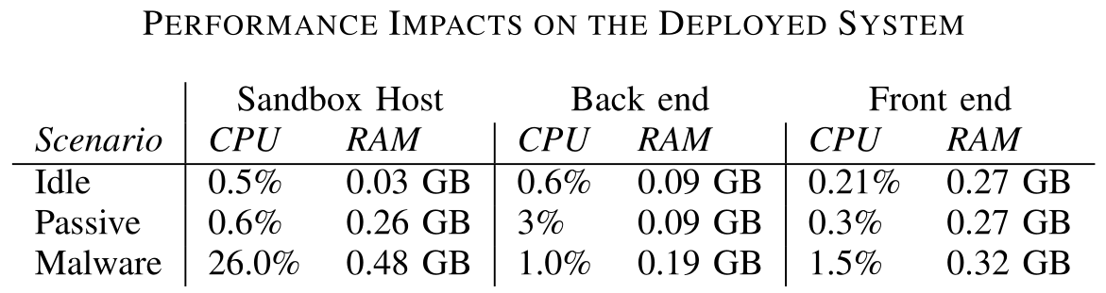
Results
Virtual machines do not consume a great number of resources.
Adding two sandboxes only increases CPU usage by 0.1%.
Running malware on one sandbox increases CPU usage by 25.4%.
Figure 1: Source: [3]

Slide 25
Further Testing
Other malware tested:
  Botnets, Ransomware, Rootkits, Data Stealers, Spyware, Cryptojackers
In each test, malware was contained.
SecBox’s hypervisor, gVisor, is designed to prevent breakouts.

Slide 26
Further Testing
Other malware tested:
  Botnets, Ransomware, Rootkits, Data Stealers, Spyware, Cryptojackers
In each test, malware was contained.
SecBox’s hypervisor, gVisor, is designed to prevent breakouts.
SecBox can safely run malware without infecting the host system.
SecBox is lightweight, and does not greatly slow down the host system.
More processing power = More efficient malware analysis

Slide 27
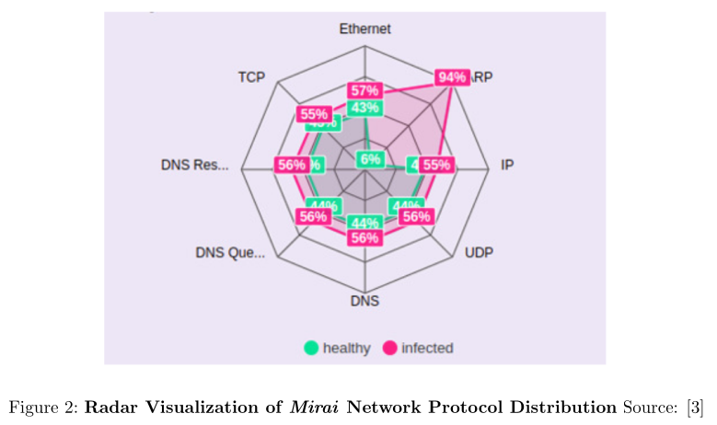
Findings
Three more case studies:

Slide 28
Findings
Three more case studies:
  Mirai (normal load)

Slide 29
Findings
Three more case studies:
  Mirai (normal load)
  Cryptojackers

Slide 30
Findings
Three more case studies:
  Mirai (normal load)
  Cryptojackers
  Mirai (high load)

Slide 31
Findings
Three more case studies:
  Mirai (normal load)
  Cryptojackers
  Mirai (high load)
Mirai causes a slight increase in all processes, but especially in ARP traffic.

Slide 32
Findings
SecBox results are consistent and reproducible.

Slide 33
Findings
SecBox results are consistent and reproducible.
  SecBox is executed on an Ubuntu virtual machine.

Slide 34
Findings
SecBox results are consistent and reproducible.
  SecBox is executed on an Ubuntu virtual machine.
  A sample of malware is deployed inside SecBox and the usage of system resources is measured.

Slide 35
Findings
SecBox results are consistent and reproducible.
  SecBox is executed on an Ubuntu virtual machine.
  A sample of malware is deployed inside SecBox and the usage of system resources is measured.
  This process is repeated ten times to compare the similarity in the results.

Slide 36
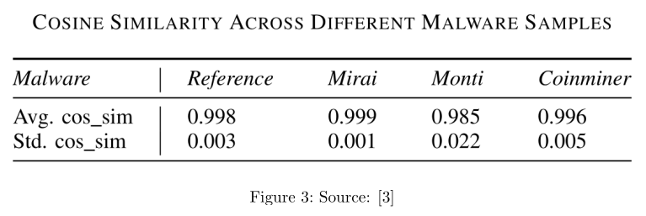
Findings
Four malware samples were executed:
  Reference, Mirai, Monti, CoinMiner

Slide 37
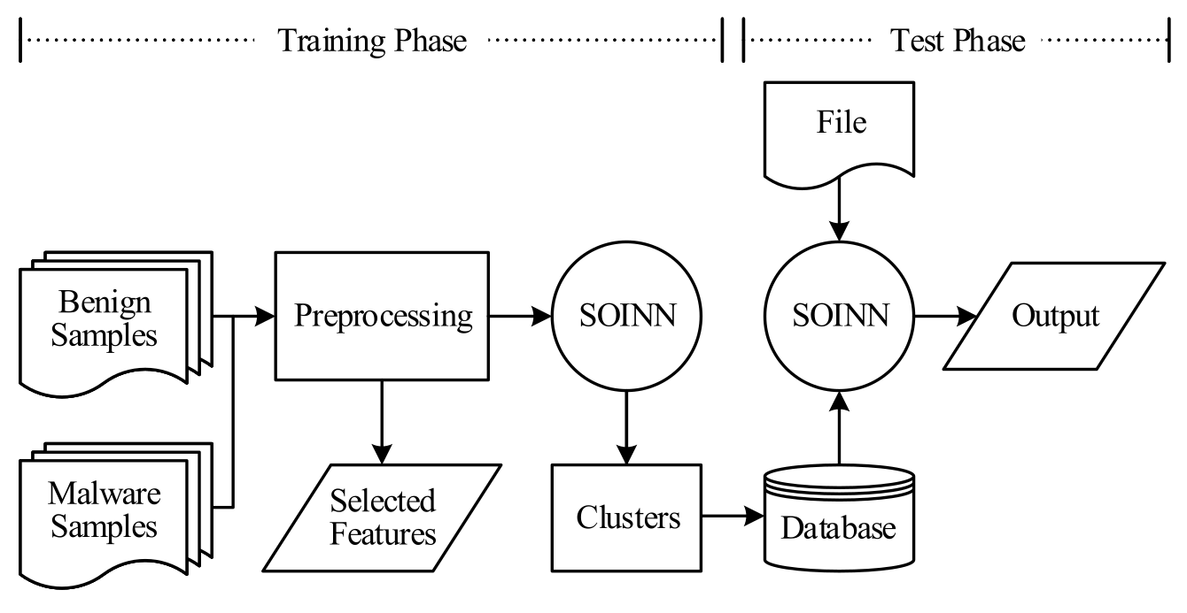
Machine Learning
Using machine learning, it is possible to train a model to recognize the difference between benign and malicious software.

Slide 38
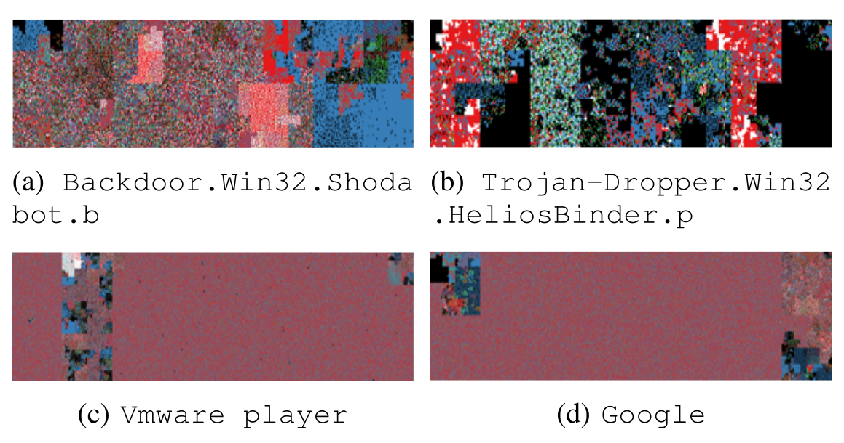
Machine Learning
The programs are given a binary visualization in a two-dimensional space.
The algorithm prints characters according to type:
  blue - printable characters
  green - control characters
  red - extended characters
  black - null characters
  white - non-breaking space
  characters

Slide 39
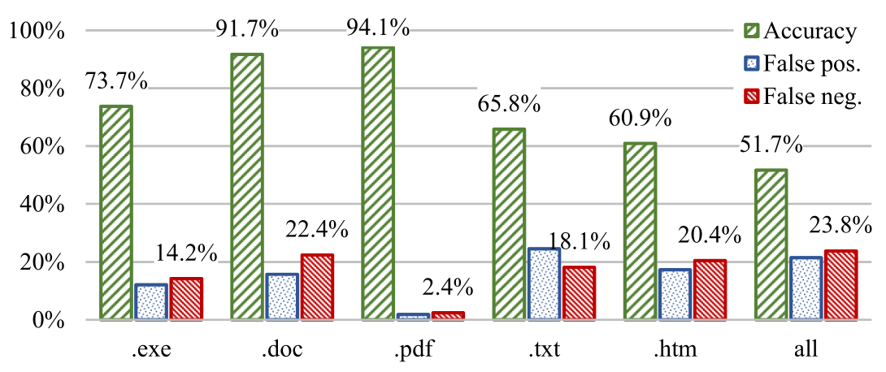
Experiments
2000 benign files and 2000 malicious files
Overall accuracy: 51.7%
Doc accuracy: 91.7%
PDF accuracy: 94.1%

Slide 40
Conclusion
Based on evidence, SecBox is effective for dynamic malware analysis.
With low overhead, it can be installed on a user’s machine without slowing the machine down.
The malware is contained so it does not infect the host machine.
Behavior-based detection is much more effective at detecting malware, even without a known signature.

Slide 41
Questions?

Slide 42
References
[1] A. H. CeldrÃ¡n, P. M. S. SÃ¡nchez, G. Bovet, G. M. PÃ©rez, and B. Stiller, “Intelligent fingerprinting to detect data leakage attacks on spectrum sensors,” in ICC 2022 - IEEE
International Conference on Communications, 2022, pp. 4080–4085.
[2] A. Blaise, M. Bouet, V. Conan, and S. Secci, “Detection of zero-day attacks: An unsu- pervised port-based approach,” Computer Networks, vol. 180, p. 107391, 2020. [Online].
Available: https://www.sciencedirect.com/science/article/pii/S1389128620300761

Slide 43
References (Cont.)
[3] C. Feng, J. Von Der Assen, A. H. Celdran, R. Mogicato, A. Zermin, V. Ok, G. Bovet, and
B. Stiller, “Secbox: a lightweight data mining platform for dynamic and reproducible malware analysis,” in 2024 11th IEEE Swiss Conference on Data Science (SDS), 2024, pp. 62–67.

Slide 44
This work is licensed under a Creative Commons Attribution-ShareAlike 3.0 Unported License.
It makes use of the works of Mateus Machado Luna.

